Slide 1


Survey Feedback
July 2025

Slide 2

Trust-wide
results
Thank you
229 people participated in last year’s Together Trust anonymised survey. This included:
145 parents
70 service users/pupils
14 people from external agencies
Your feedback is much appreciated and helps us improve our services. We will be repeating this exercise later this year

Slide 3

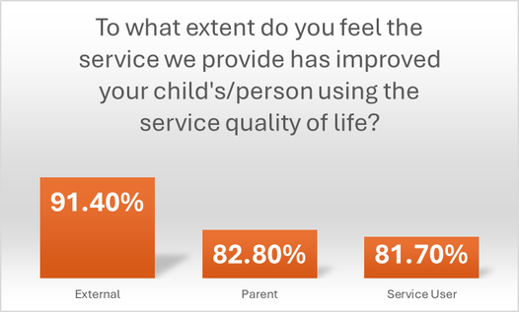
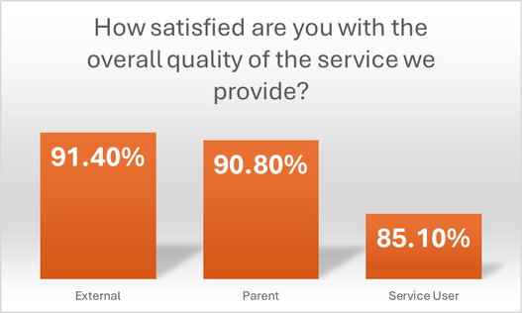
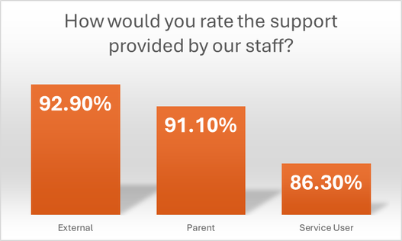
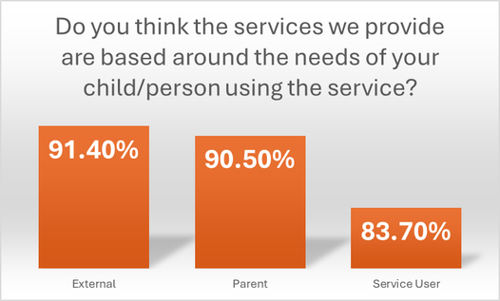
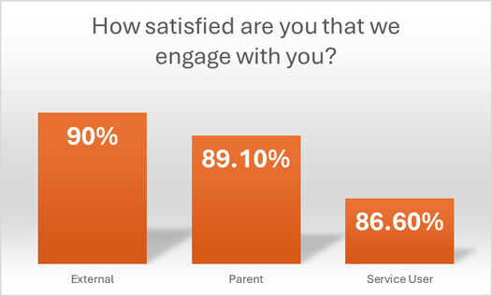
Trust-wide
results
Scores
Participants could score questions from 1 to 5.
1 = 20%
5= 100%
The average score for multiple services was 87.8%
Average responses by group:
Service Users/Students was 87.8%
Parents was 88.9%
External agencies was 91.4%

Slide 4

Inscape House
Inscape House Responses
78 people responded to the anonymised survey for Inscape House. This included:
52 parents
26 pupils

Slide 5
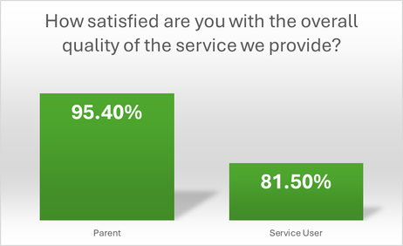

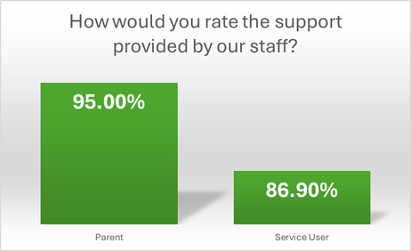

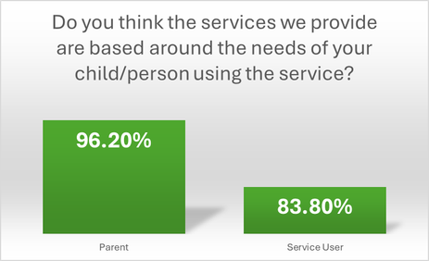
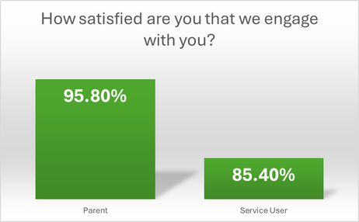
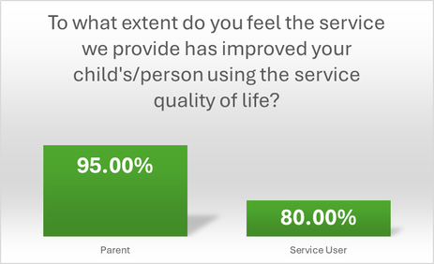
Inscape House
Scores
Participants could score questions from 1 to 5.
1 = 20%
5= 100%
The average score for multiple services was 91%
This is higher than the Trust-wide average of 88%
Pupils scored slightly lower than parents, which could be expected.

Slide 6


Inscape House
Feedback
You said...
You said...
You said...
That parking and drop off/collection time was an issue due to the restricted road width and lack of parking spaces.
You said how great staff were with the children but were concerned about potentially high staff turnover.
You had concerns about when your child reaches adulthood and leaves the school.
We did...
We did...
We did...
We successfully trialled a new system to improve things. This includes a one way system and specific parking/drop off points to ease congestion. We will continue to review this and make further adjustments, if needed.
Whilst staff turnover in the Trust is quite low. We want to maintain and reward our staff at all levels. In addition to their salary and pension contributions we offer long service rewards, and we recently introduced a reward scheme for staff to save money on everyday spending.
We are focused on promoting independence and teaching life changing skills to equip our young people to face life’s challenges. Additionally, our vocational college provides training opportunities for those aged 16 to 19. Whilst Inscape can usually only support your child until they are 19, the Trust does offer community day centres for young adults. We also now have Together Futures which offers partnership, internship and work experience opportunities

